Slide 1
CFD F1 MCM

Slide 2
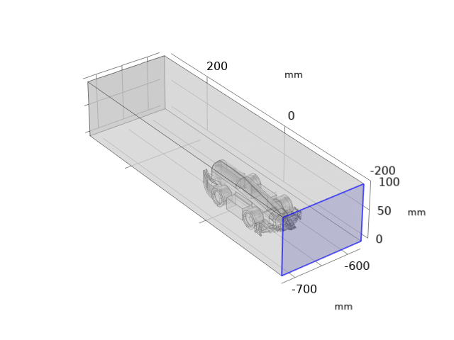
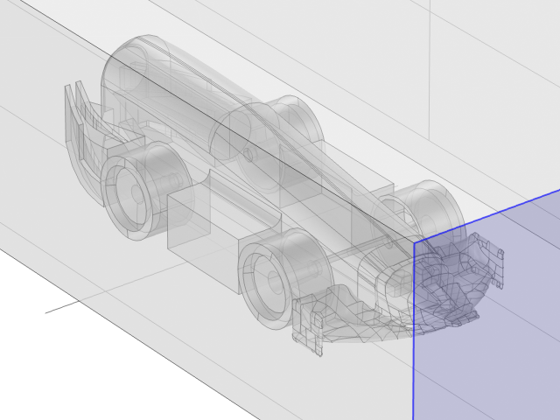
Model
outlet
400 mm
100 mm
Variable
Single or double rear vanes
inlet

Slide 3
Assumption
Tyre fixed
Cannister is ignored
Rear wings is removed for simplicity (actually keep facing issue at one surface with bad facets)
Assuming subsonic – flow is assumed as incompressible

Slide 4
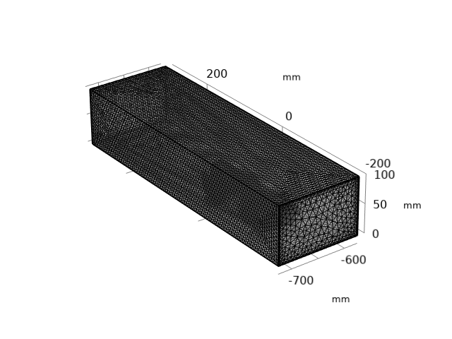
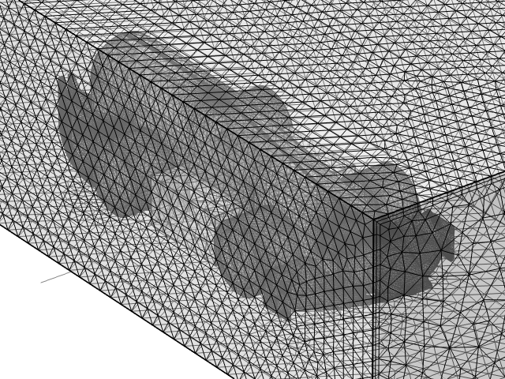
Mesh

Slide 5
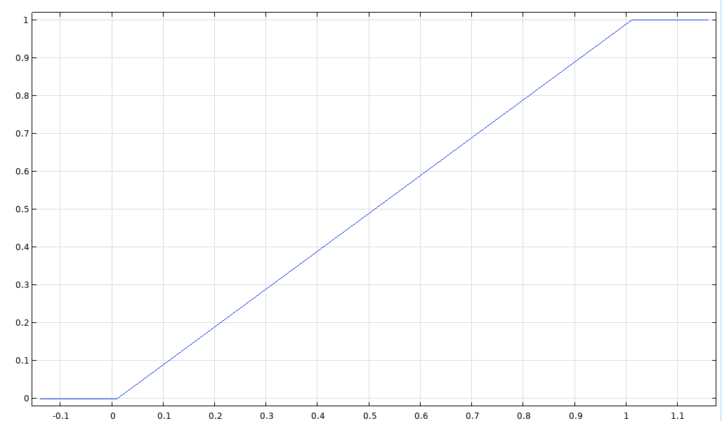
Boundary condition
Inlet velocity (1 is max)
Inlet – 25 m/s (this is ramped over 1 s)
Time dependent simulation (Inlet is ramped from 0 to 25 m/s)
Outlet – zero pressure
The rest of boundary is set as wall or zero velocity
Simulation is run in COMSOL 6.1
Time (s)

Slide 6
Result
Total drag (mN) across time
Time (s) | Inlet Velocity (m/s) | Single Vane (mN) | Double Vane (mN)
0.1 | 2.25 | 1.8056 | 1.6785
0.2 | 4.75 | 3.3874 | 3.5279
0.3 | 7.25 | 5.2954 | 5.5656
0.4 | 9.75 | 7.3611 | 7.6892
0.5 | 12.25 | 9.4996 | 9.8611
0.6 | 14.75 | 11.660 | 12.056
0.7 | 17.25 | 13.826 | 14.262
0.8 | 19.75 | 15.992 | 16.472
0.9 | 22.25 | 18.151 | 18.683
1 | 24.75 | 20.236 | 20.819
1.1 | 25 | 20.501 | 21.088

Slide 7
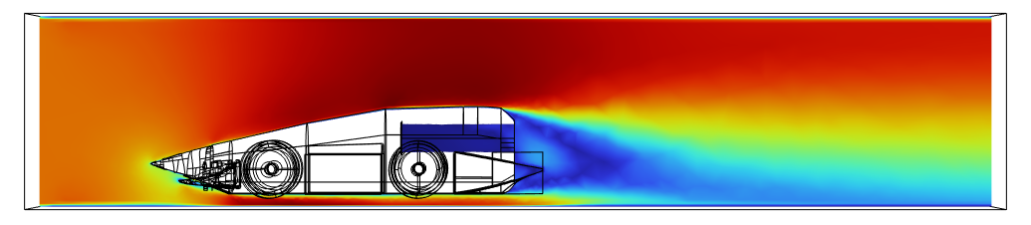
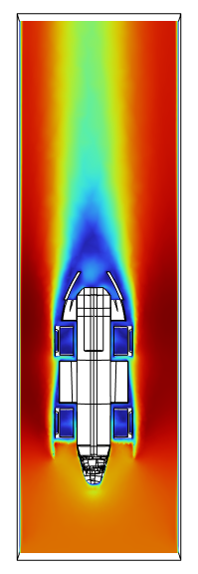
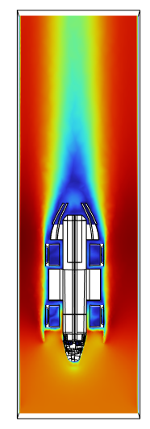

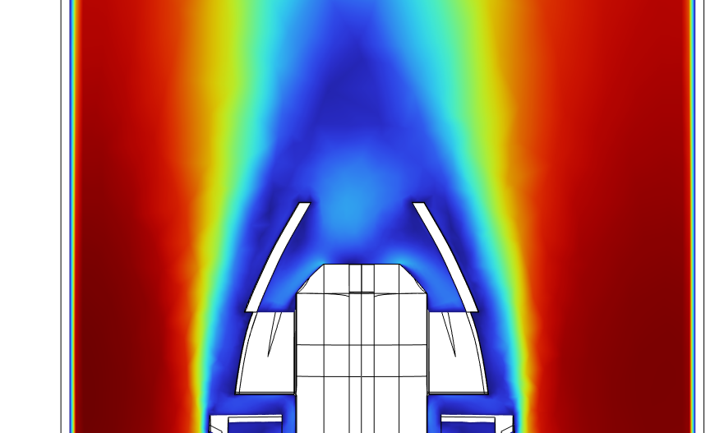
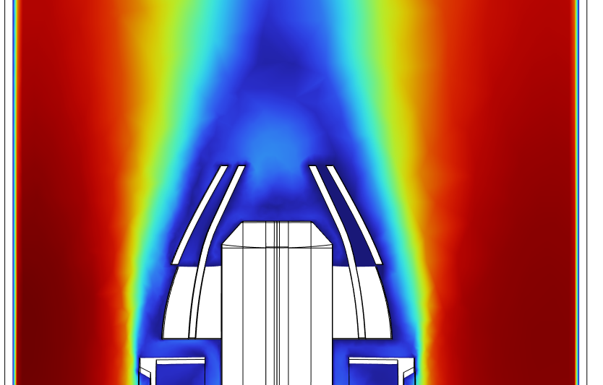
Fluid Velocity
Single vane
Single vane
Double vane
Double vane
Single vane
Double vane

Slide 8
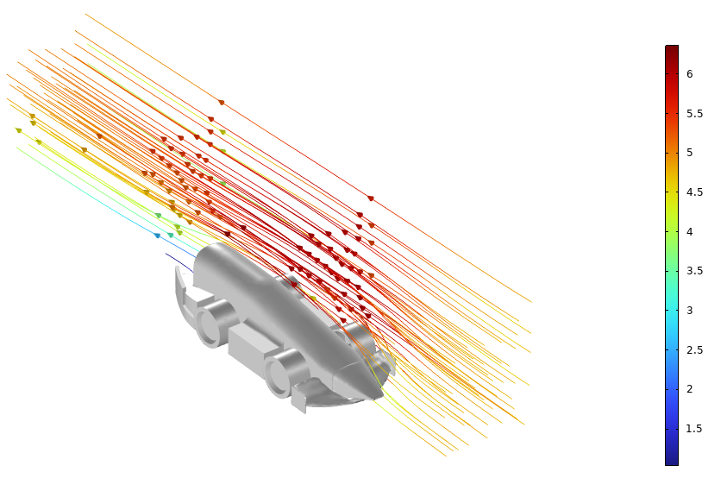
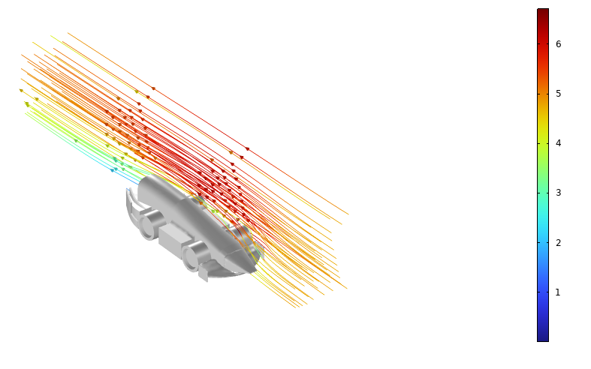
Fluid streamline
Single vane
Double vane

Slide 9
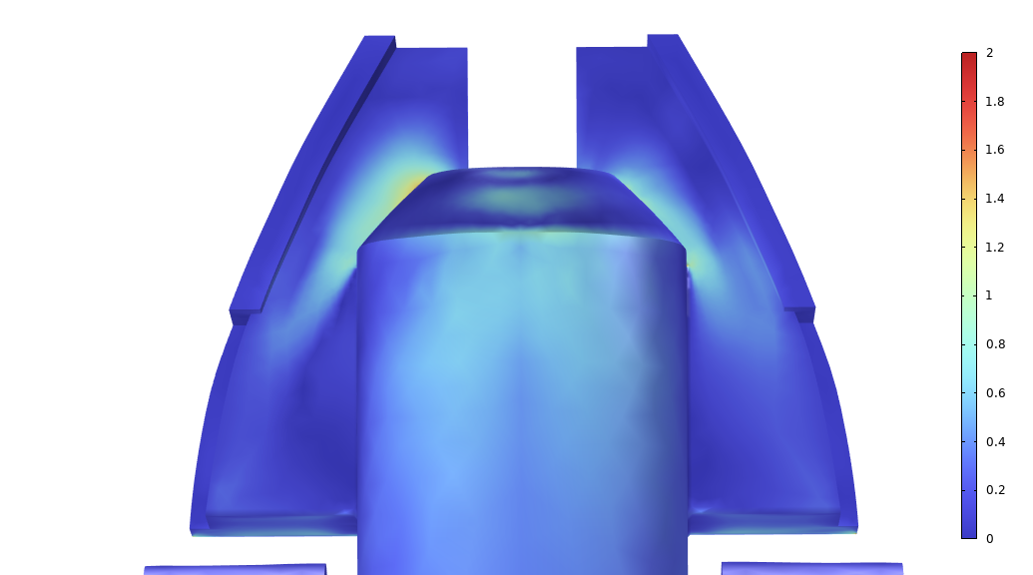
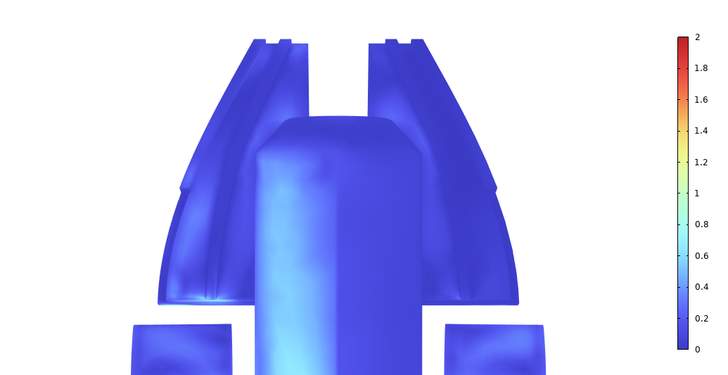
Wall shear stress at the rear (Pa)
Single vane
Double vane

Slide 10
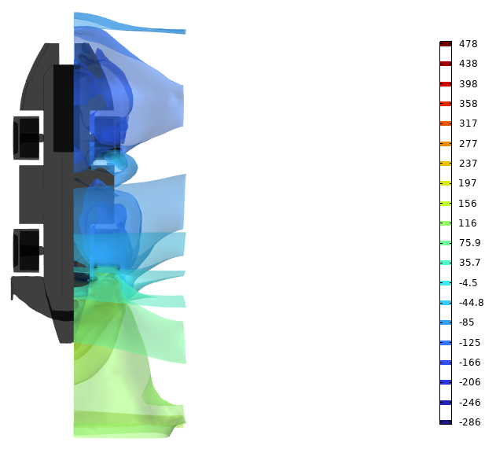
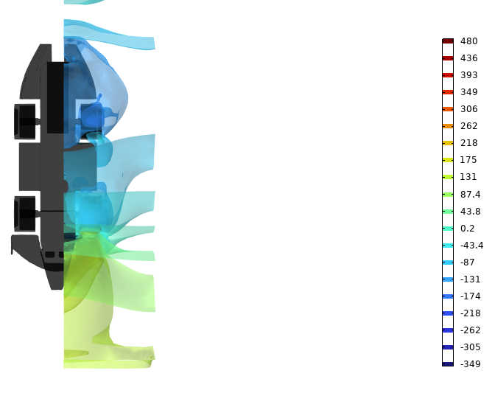
Pressure Isosurface (Pa)
Single vane
Double vane

Slide 11
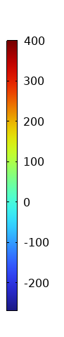
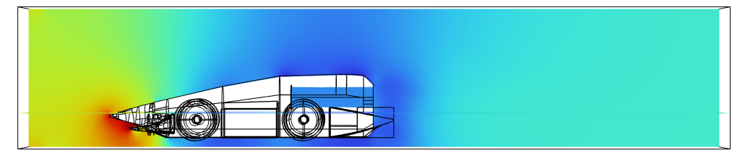
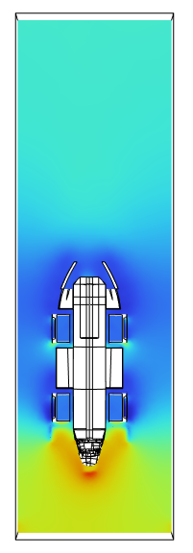
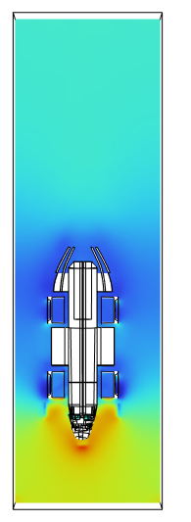
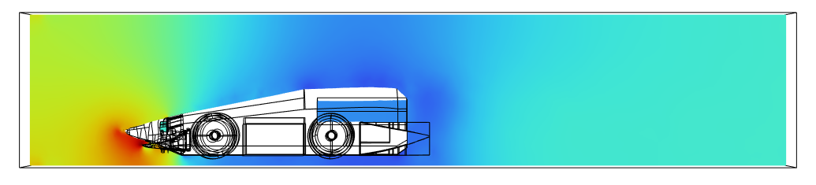
Pressure (Pa)
Single vane
Single vane
Double vane
Double vane

Slide 12
Comments
The drag seems to be less in single vane (not by much), probably due to the double vane imposes additional flow resistance.
However, the drag is greatly influenced by mesh
The vanes seems help to orient the pressure so low pressure is nearer to the cannister outlet, which might help to propel the car

Slide 13
Limitation
Mesh is quite coarse and some facets issue in the surface between the wings and body, this might affect drag calculations and pressure
Normally we would refine the mesh by halving the size 4x to ensure the results no longer change
I noticed some parts contains sharp edges, especially in the rear wings, which makes it difficult to import into model,
For future work, best to merge all the parts (components) in the CAD, using Boolean operator
Assumption of no turbulence

